Slide 1
Parents Guide to Admissions

Slide 2
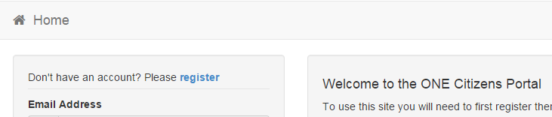
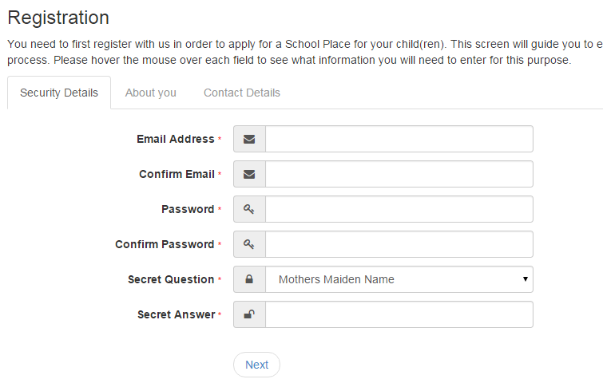
Registration
Click register
Add your security details

Slide 3
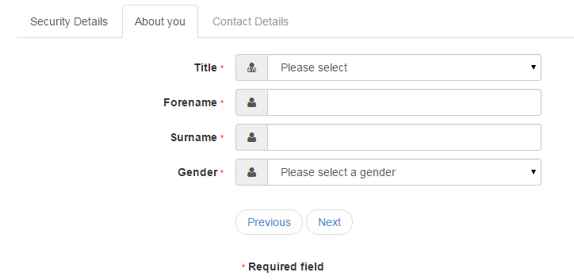
Who you are
Add your security details

Slide 4
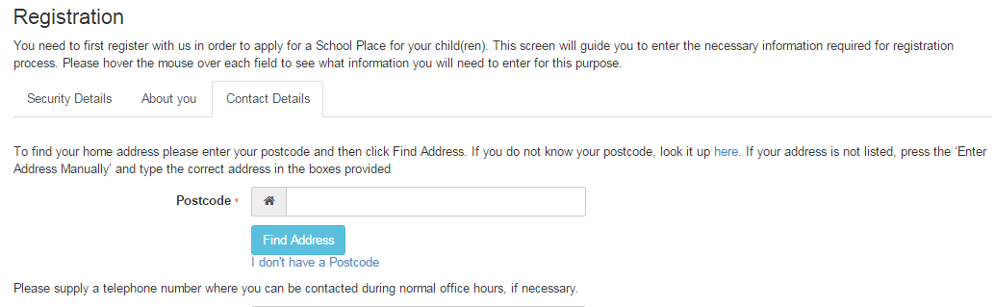
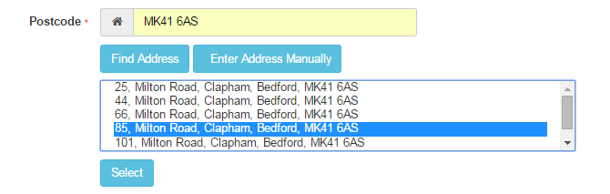
Where do you live
Enter your Post Code
Find Address
If you don’t find your address you can type it in Enter Address Manually
Click on Address
Select

Slide 5
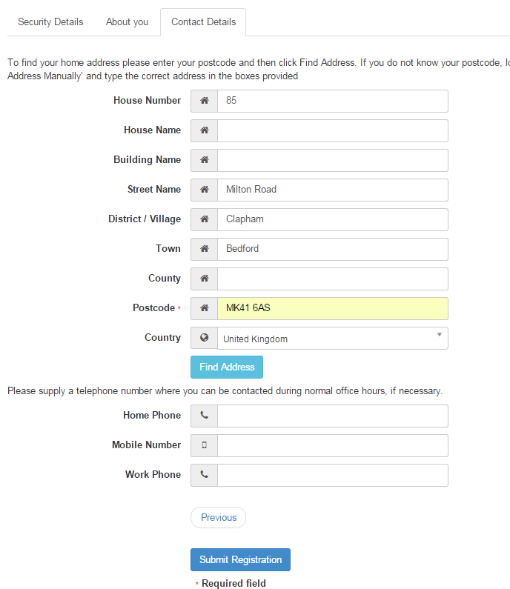
Give us your contact details
Enter your telephone Numbers
Submit Registration

Slide 6
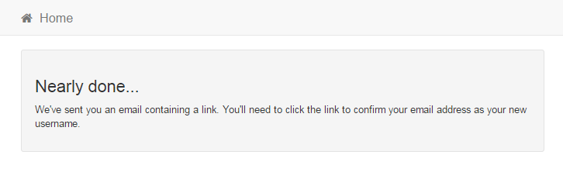
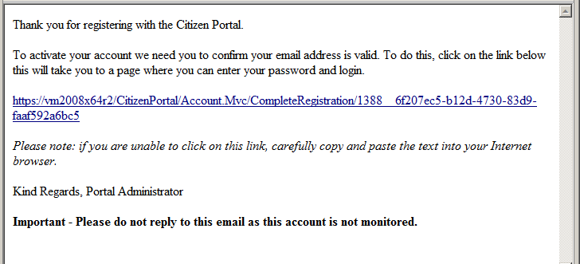
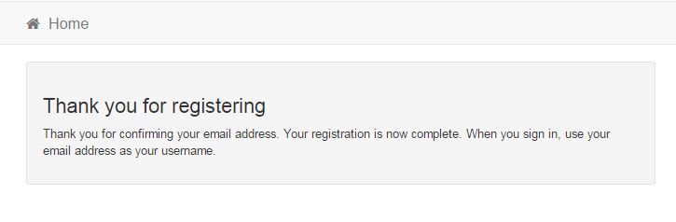
What happens Next
Click on the link
You get an Email
If the email is not in you inbox, check your Junk Mail folder
If the link is not highlighted copy and paste into your browsers URL box

Slide 7
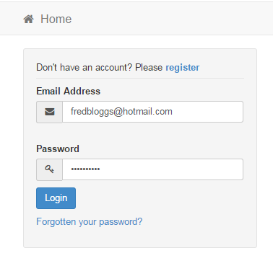
Log in
Email
Password
Login
If you have forgotten your password follow the ‘Forgotten your password?’ link

Slide 8
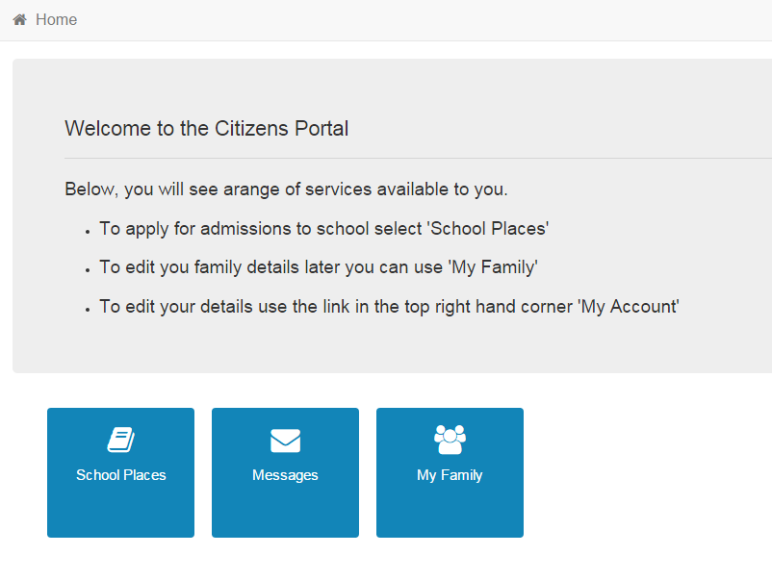
Your Home Page
Click School Places
If you have more than one child you only need one account

Slide 9
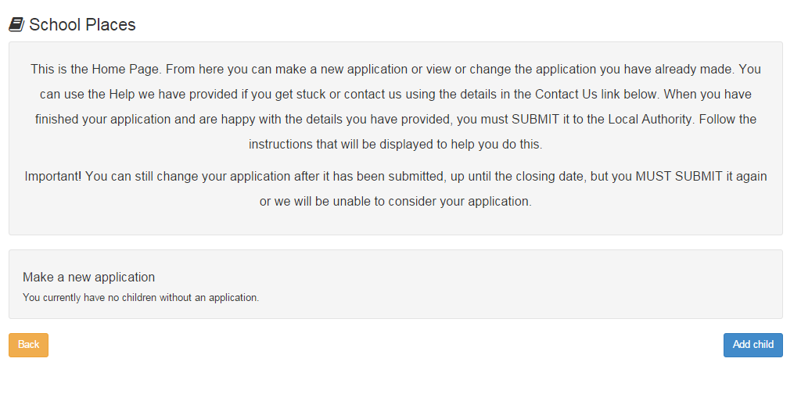
Adding an Application
Click Add Child
If you already have children added via another service or My Family they will be shown here

Slide 10
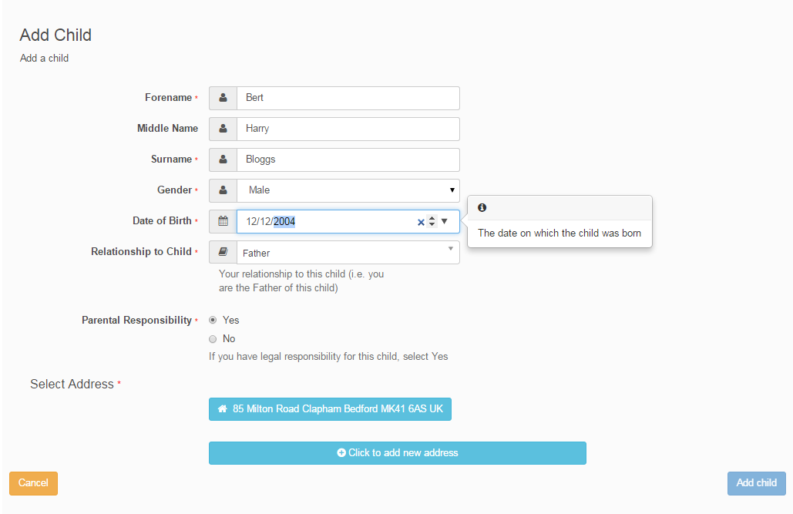
Add your child
Enter you child’s legal names, gender and date of Birth
Relationship
Confirm they live with your or click in the box below to add their address

Slide 11
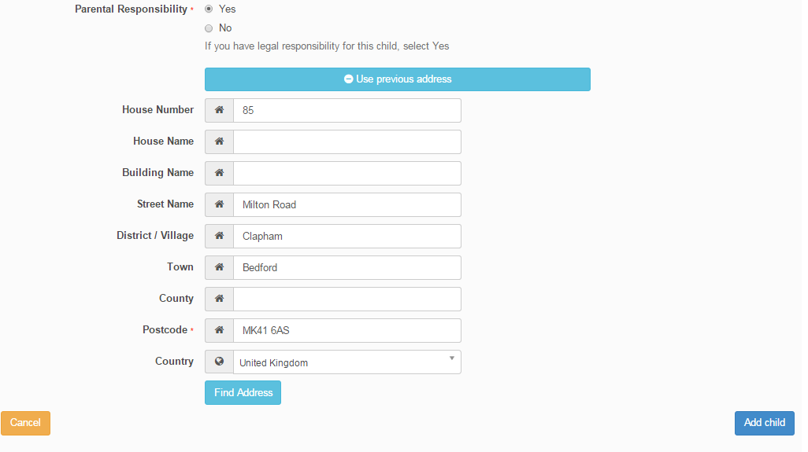
Add Child cont..
Click Add Child

Slide 12
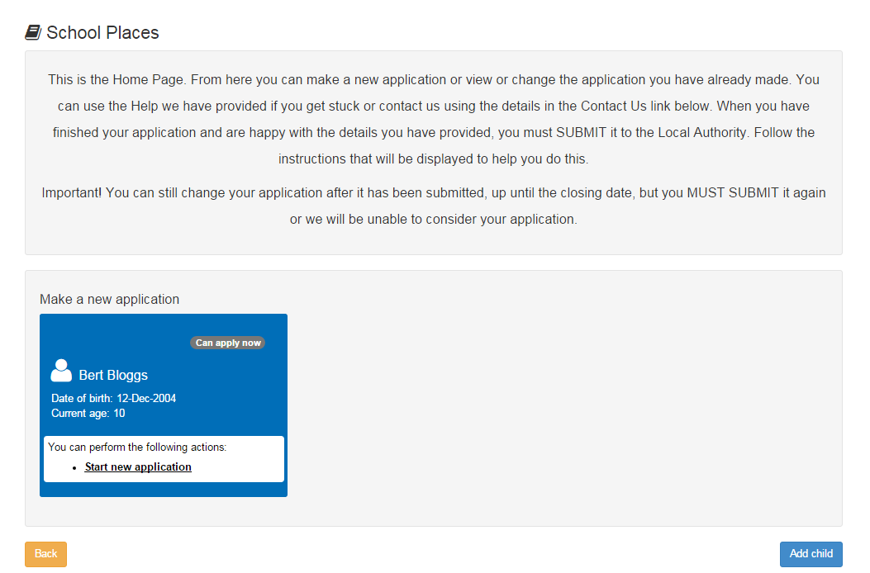
Start the application
Start new Application

Slide 13
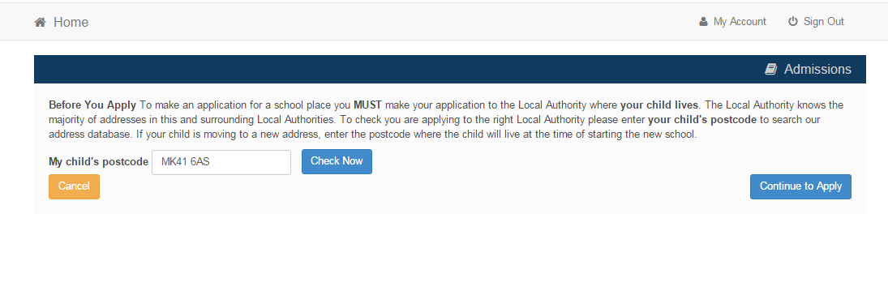
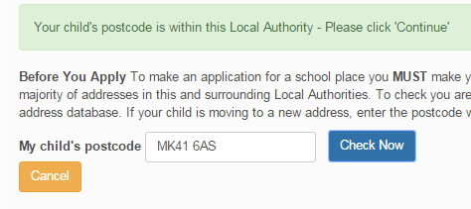

Which Local Authority do you live in?
You should check you are using the right website to apply for a school place

Slide 14
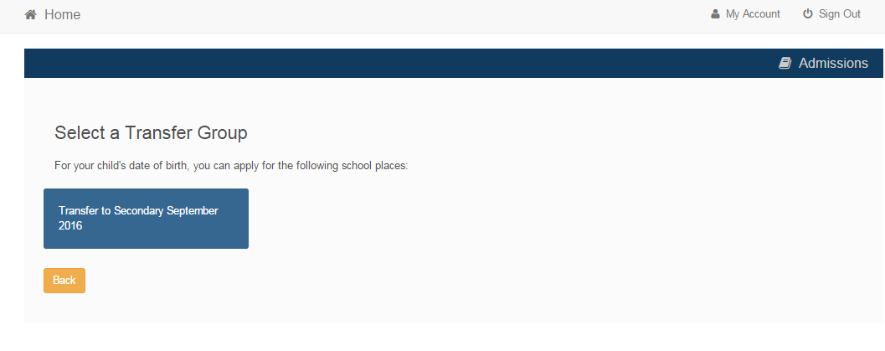
When is your child changing school?
Click the Box
If you don’t get an Admissions Transfer Group you maybe too late in applying or your child’s date of birth is out of range – either way please contact Admissions on 233 3006 or by e-mail at admissions@liverpool.gov.uk

Slide 15
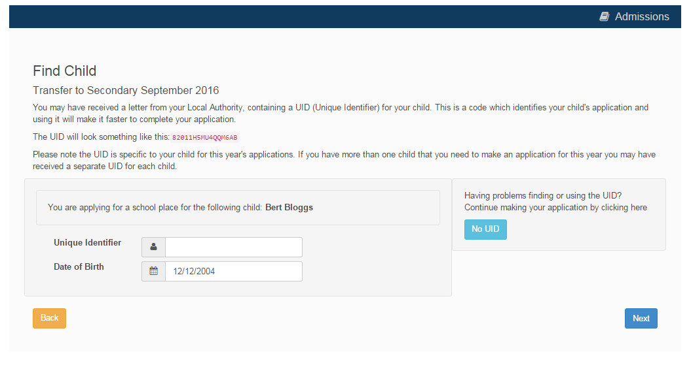
If you have a UID?
Or
No UID
Enter your UID
Then press Next

Slide 16
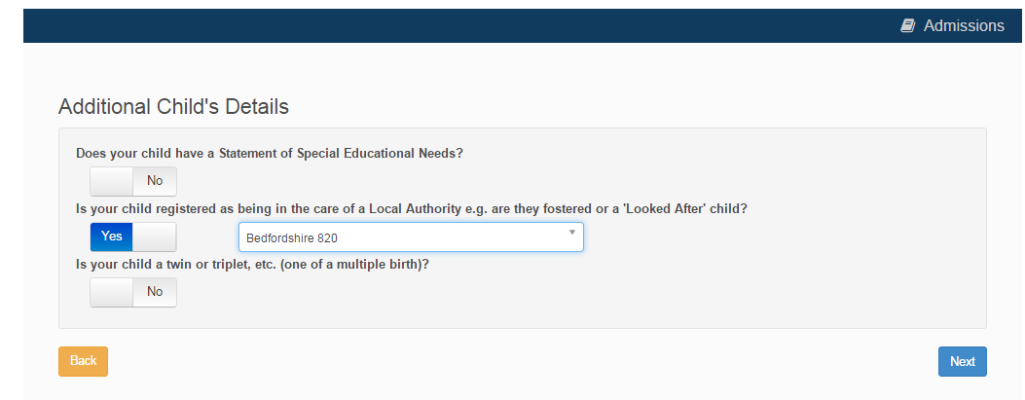
Your child’s details?
Slide to select
Next

Slide 17
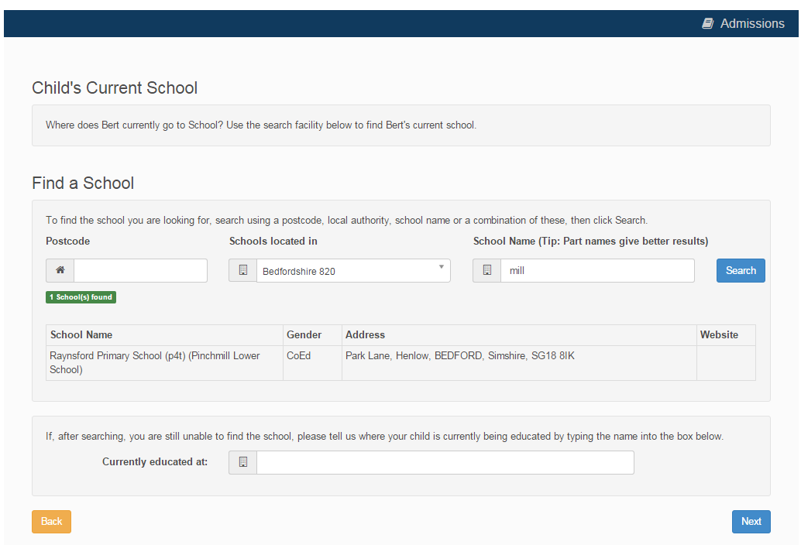
Current School
IMPORTANT – If your child is applying for a place in reception skip to ‘Your Preferences’ on Slide 19.
If you used a UID you will skip this page anyhow.
Search for your child’s current school
Select
If your school is not listed change remove the Postcode and change the Schools located in to your local authority

Slide 18
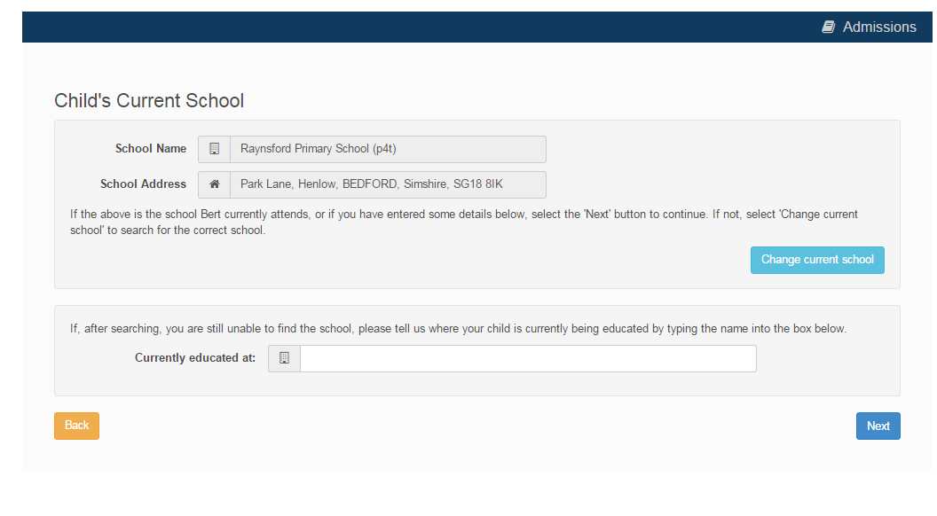
Confirm School
IMPORTANT – If your child is applying for a place in reception skip to ‘Your Preferences’ on the next slide, Slide 19.
Next
If your child is not in school please tell us in the box at the bottom

Slide 19
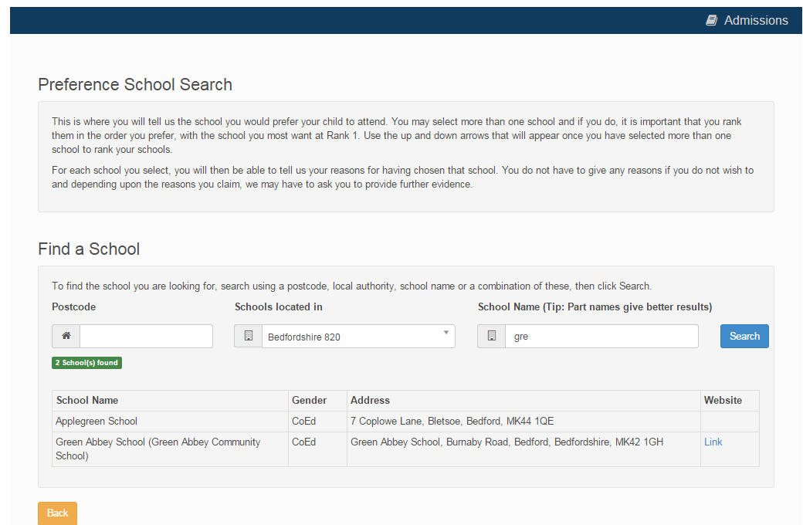
Your Preferences
Search for your school
Schools Located In
Select
If your school is not listed my default remove the Postcode and change the Schools located in to your local authority and enter part of the school name

Slide 20
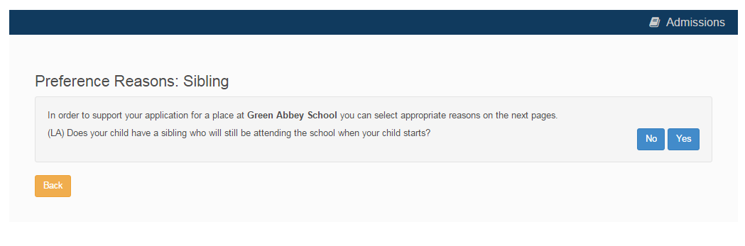
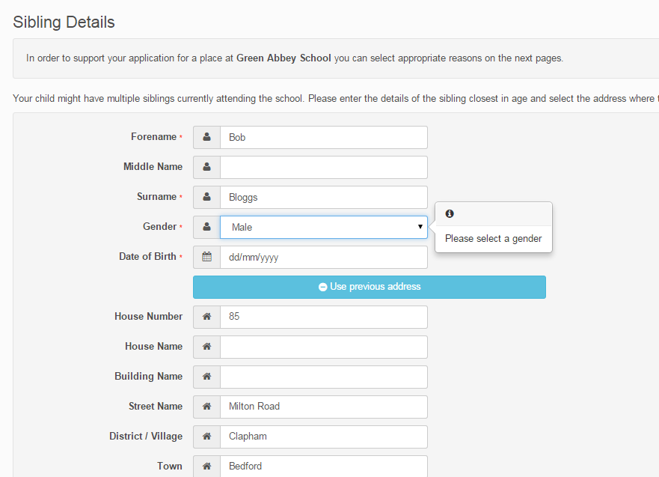
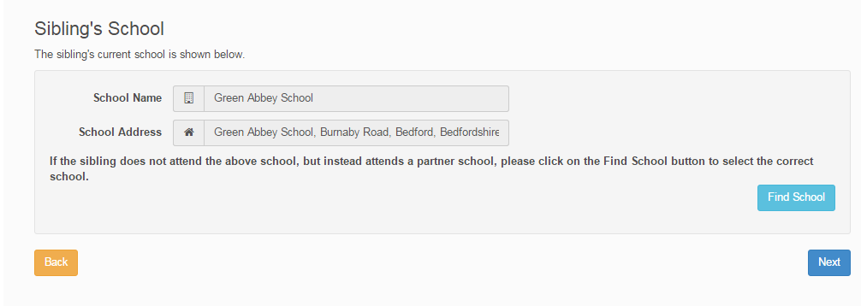
Sibling attending the school?
Click No or Yes
If Yes
Tell us about them

Slide 21
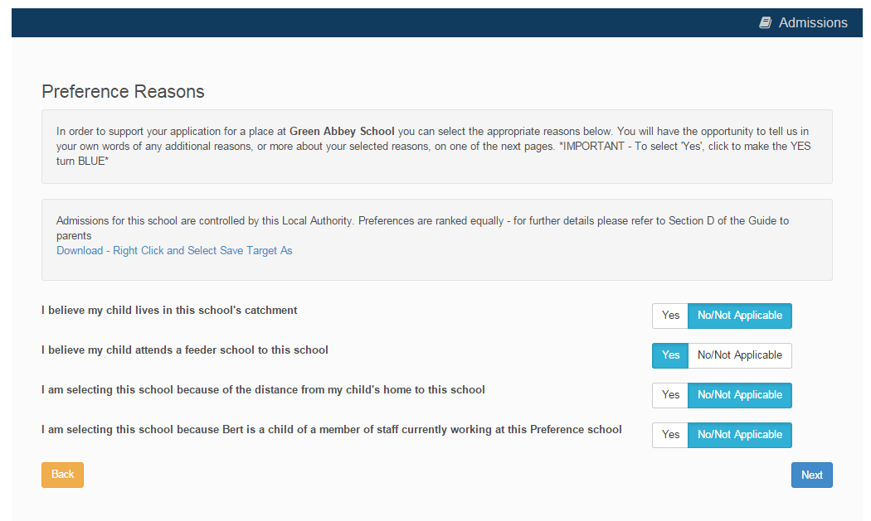

Tell us your Reasons
Next
Slide to highlight Yes as Blue

Slide 22
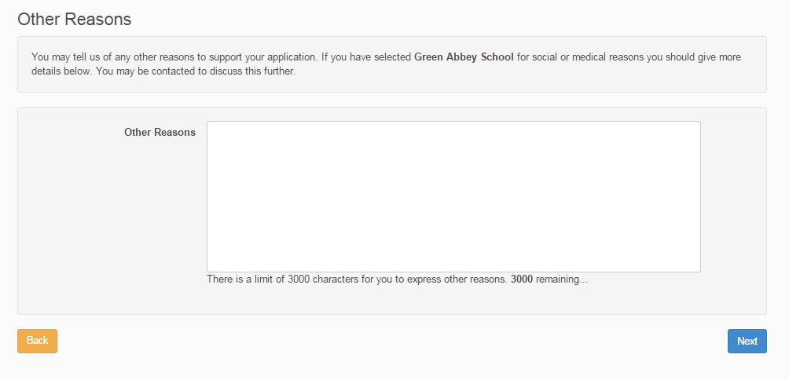
Anything else we should know?
Type in here
Next
Your reasons must be relevant to the schools admissions oversubscription criteria

Slide 23
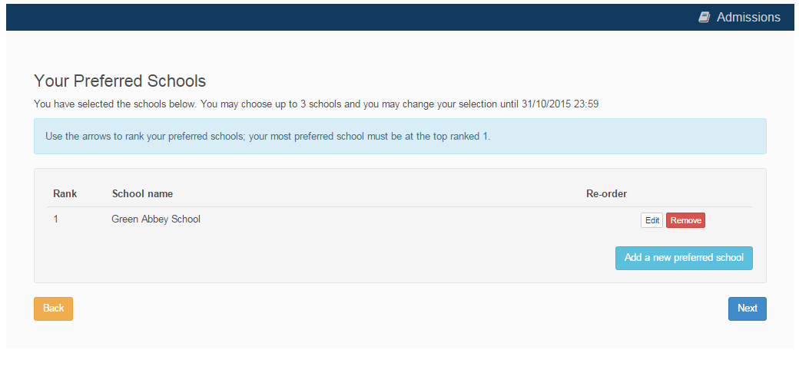
More Preferences
Add more preferences
Next
Your can add up to the maximum number of preferences, and we strongly recommend you add more than one

Slide 24
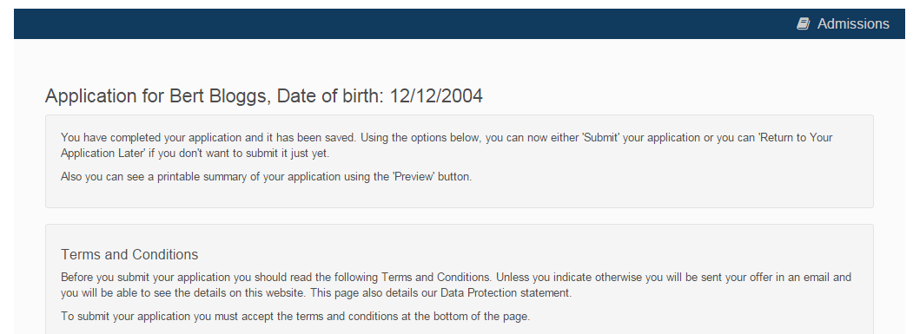

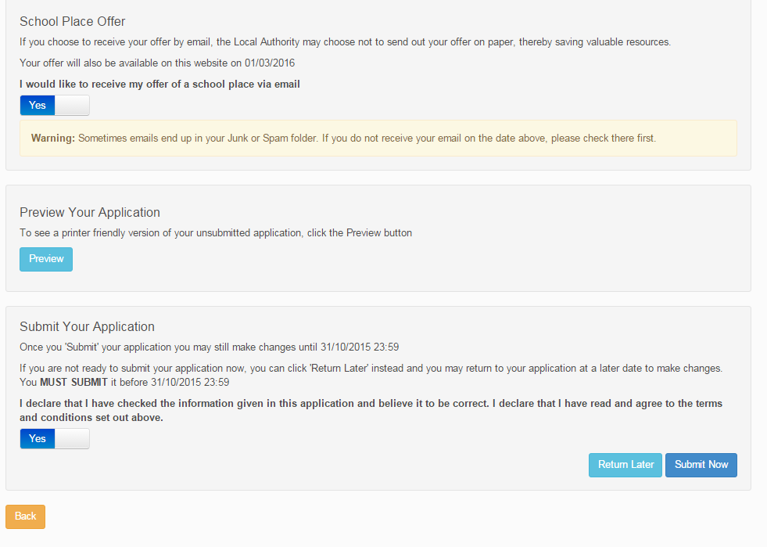
Submit Application
Read the Terms and conditions
Offer by Email?
Preview and check your application
Finally – ‘I declare’ and Submit Now

Slide 25
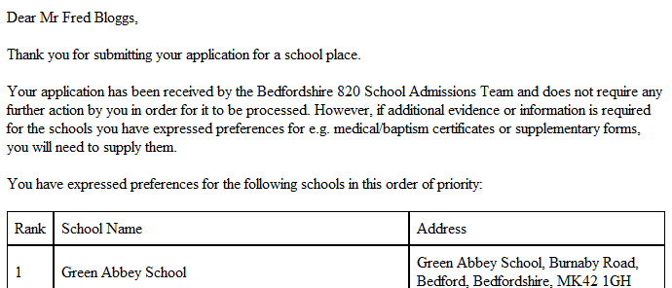
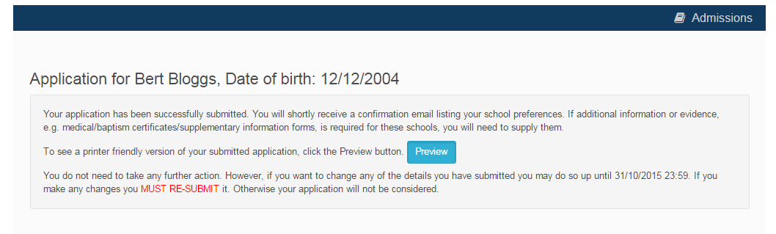

What next?
Email
Confirmation on Screen

Slide 26
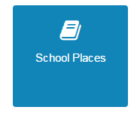
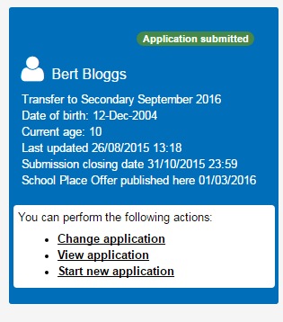
What next?
You can return to the Citizen Portal and at any time change your application up until the closing date.

Slide 27
FAQ’s
I have filled in the online form to register but have not yet received an email
  It is possible that the email has been quarantined by anti-spam measures taken by your Internet Service Provider or by settings in your mail client.
  Check to make sure that, if you are an Outlook/Outlook Express user, the relevant email has not been misidentified as "junk" and deposited in the Junk folder. If the email has definitely not been delivered to you then contact your ISP to see whether the email can be tracked and its fate discovered.
  The service providers who suffer most from the problem of incorrectly identifying key emails as spam have proved to be aol.com, hotmail.com, hotmail.co.uk, yahoo.co.uk, yahoo.com and btinternet.com
I have forgotten my password
  Visit the Welcome page log in page, click on the link "Forgotten your password?" and enter your username.
  A new email will be generated and sent to your registered email address with a link to reset the password details.

Slide 28
FAQ’s
What if I change my email address??
  Log in with your old address and select ‘My Account’
I am unable to find my address on the dropdown address list
  Just enter your address into the address boxes

Slide 29
FAQ’s
Can I use the same account to make more than one application (e.g. applications for twins or siblings in different year groups)
  You are able to apply for twins, triplets etc. using the online admissions system but MUST ensure that you submit a separate application for each child.

